Slide 1

Web Scraping Project
-- Women’s shoes from Macy’s website: https://www.macys.com/shop/shoes/all-womens-shoes?id=56233
By: Cassandra Jones
NYC Data Science Academy

Slide 2
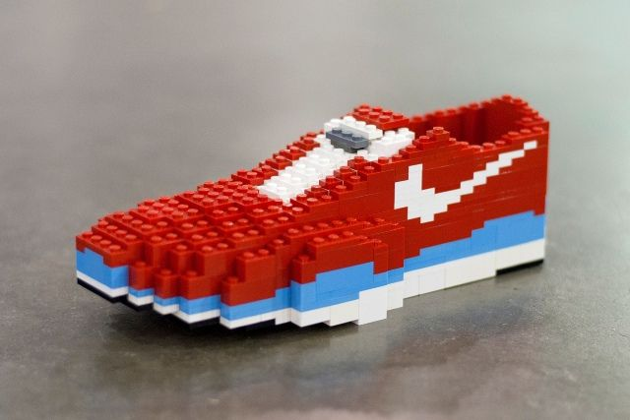
Procedure of Analysis
How ladies evaluate the shoe marketing?
Web scraping
Scrapy & Anaconda Prompt
Missing values
Data cleaning
Data analysis
Jupyter Notebook
Data cleaning
Seaborn & matplotlib.pyplot

Slide 3
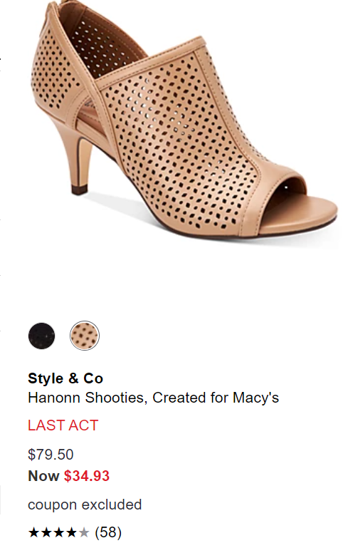
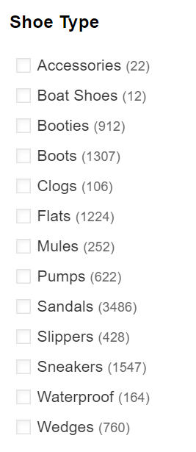
Web Scraping
Data features:
Brand
Description
Shoe type
Original Price
On-sale price
Number of review
Rating

Slide 4
Shoe Type
Why choose shoe type?
Use for loop to click on each of the shoe type
Create a meta to combine shoe type and other data
Exclude “Accessories”
Data cleaning:
Boat Shoes: “boat&20shoes” is used in url

Slide 5
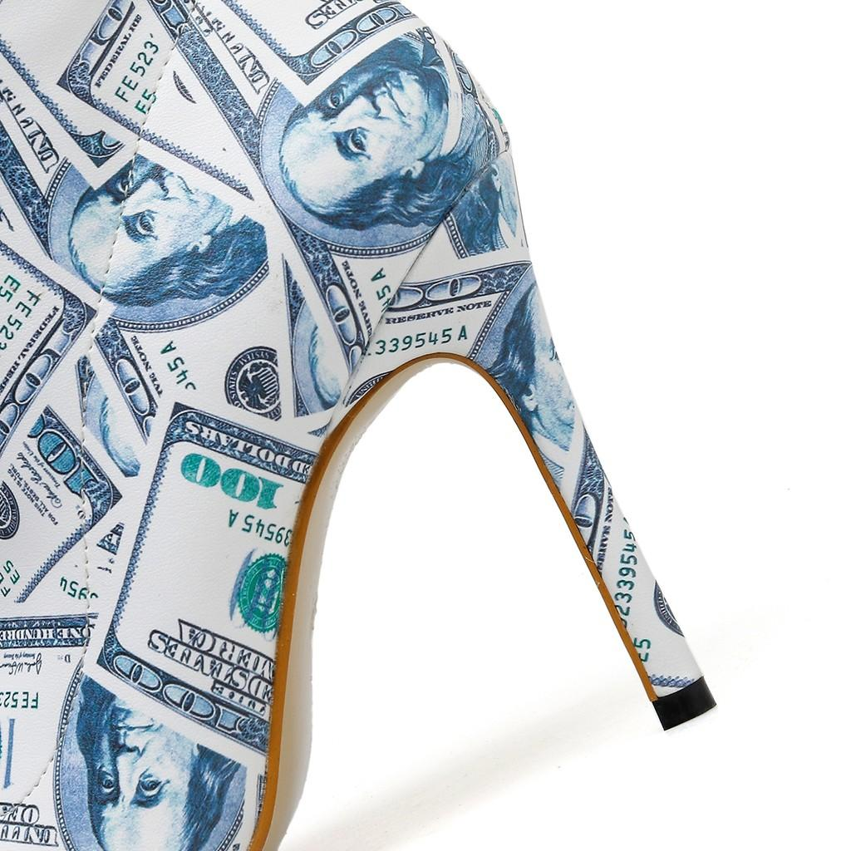
prices
Original price
Data cleaning: delete dollar sign and convert to float
On-sale price
Data cleaning:
Delete dollar sign and convert to float
Null value: insert original price

Slide 6
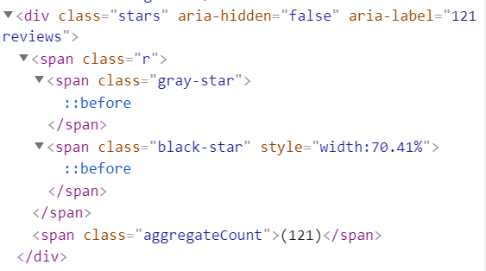
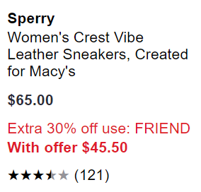
Reviews & Rating
Number of review
Data cleaning:
extract number only and convert to integer
Null value: insert 0
Rating
Data cleaning:
Extract the number of width of the black star
Null value: 0.0

Slide 7
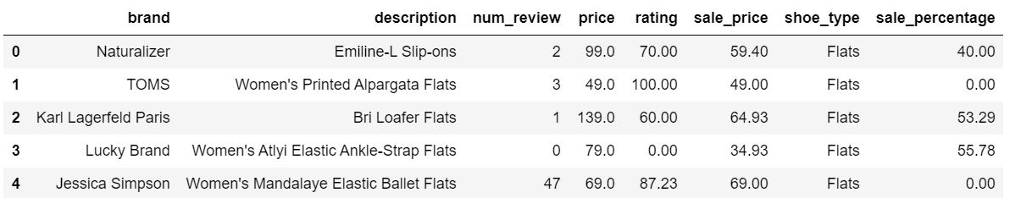
Data analysis
Use Jupyter notebook
Insert a column to calculate the sale percentage of each item
There are 10,782 items with 209 brands

Slide 8
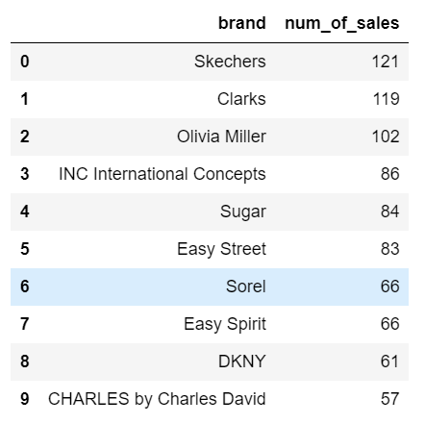
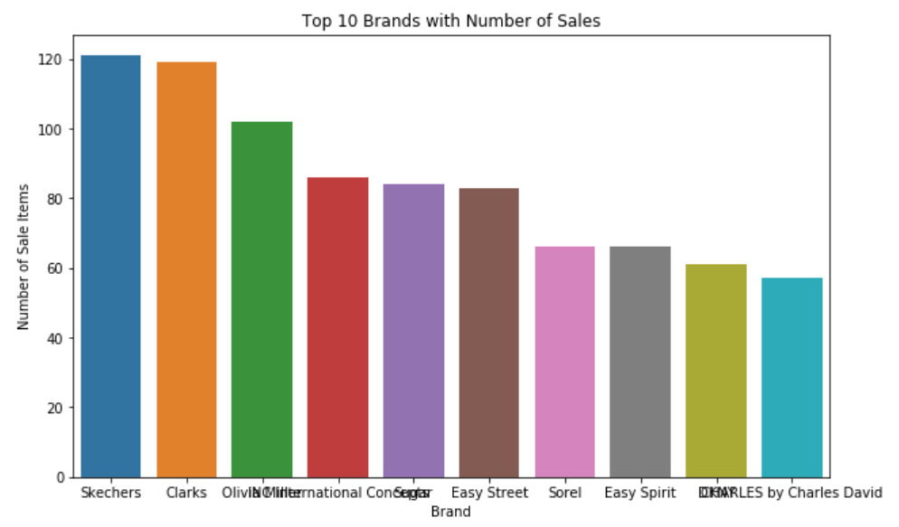
On-sale Shoes
Select shoes with none 0 sale percentage
Here is top 10 brands with most shoes on sale

Slide 9
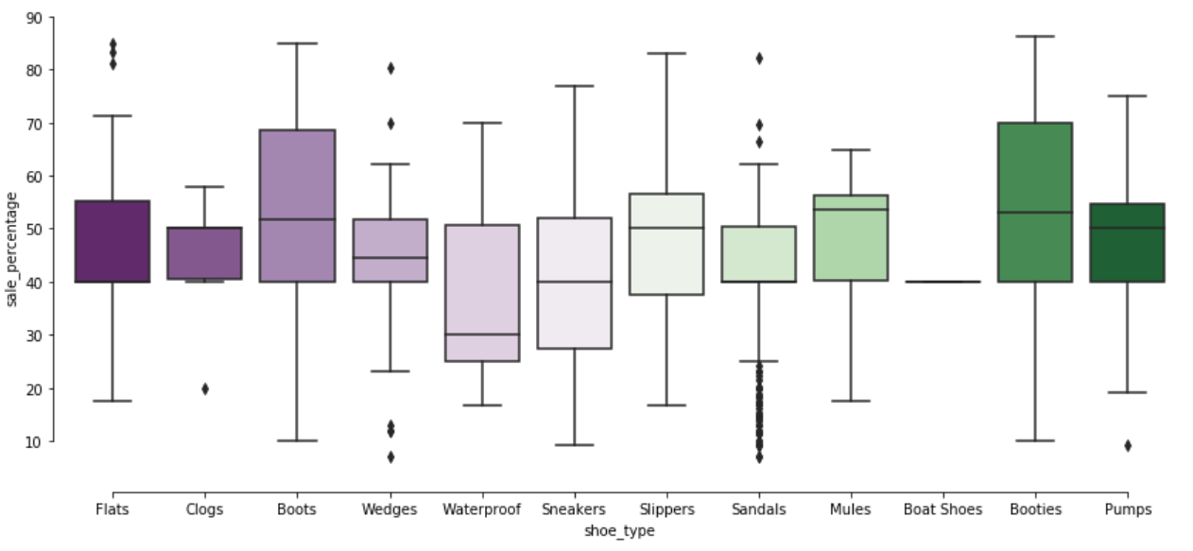
On-sale Shoes
Are winter shoes have a higher sale percentage?

Slide 10
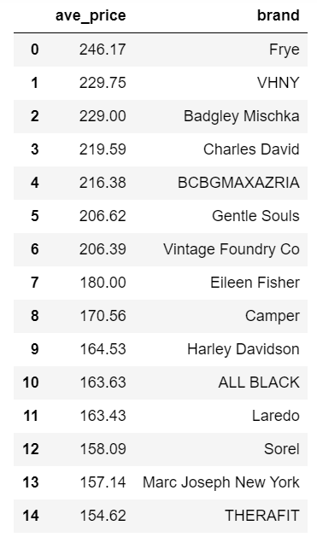
Original Price
Top 15 expensive brands
Analyzed based on original price

Slide 11
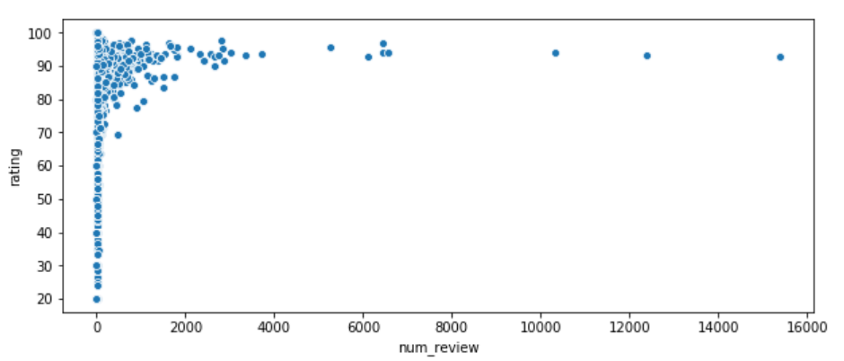
Reviews and Rating
Select data with none 0 number of review
Relationship between number of review and rating

Slide 12
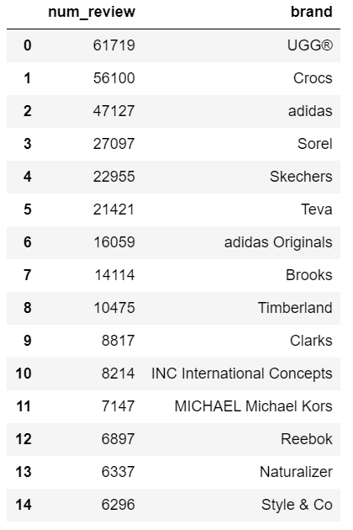
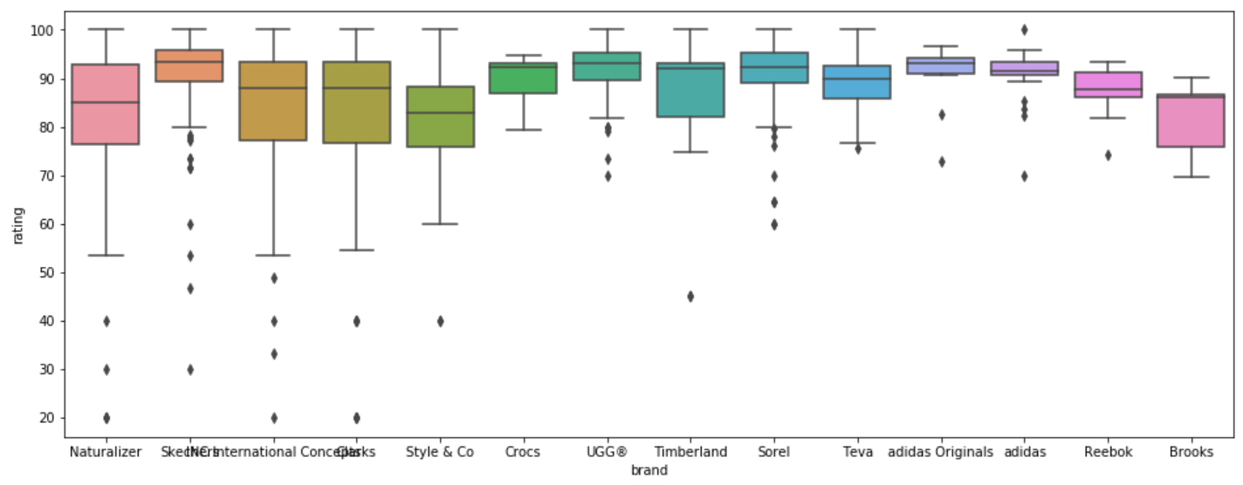
Popular Brands
Find the top 15 popular brands with number of review

Slide 13
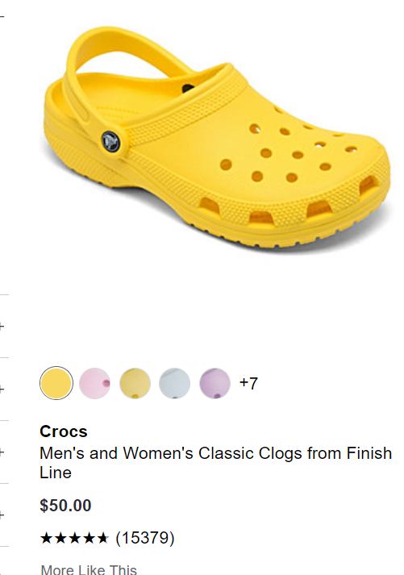
Best Seller !!
the shoes with the most number of reviews !!!

Slide 14
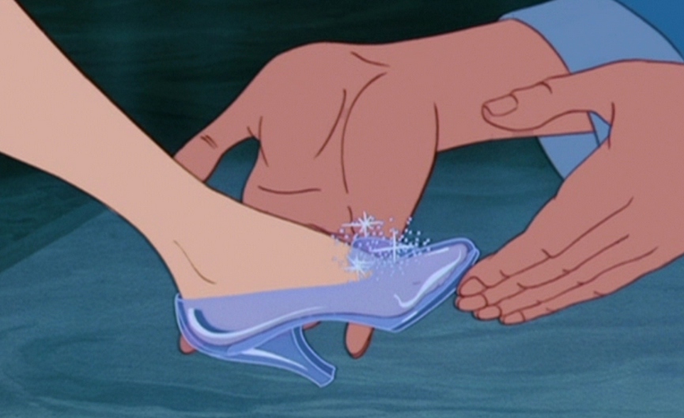
What I Learned
Be very careful to find the xpath when scrap
Try to clean the data as much as possible when scrap
Scrapy is much easier than Beautifulsoup

